Slide 1
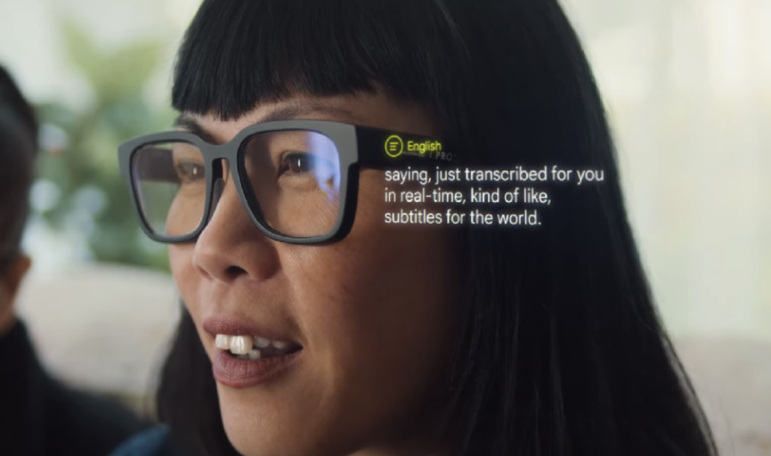

Live-Captioning Glasses & Communication
Gabriela Knox
Communication & Journalism
Texas A&M University
21 February 2025

Slide 2
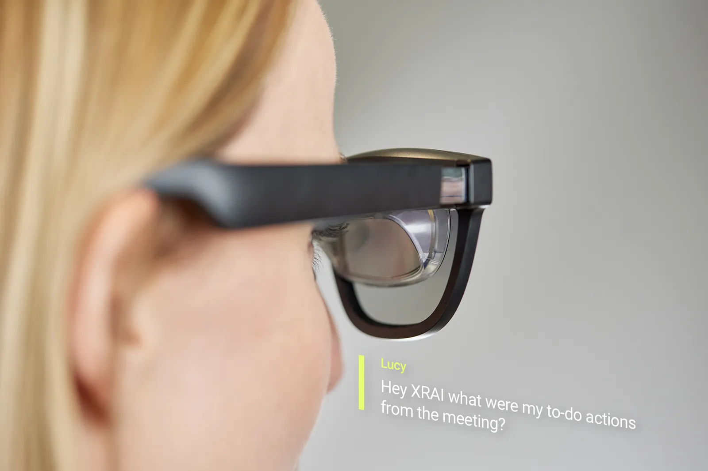
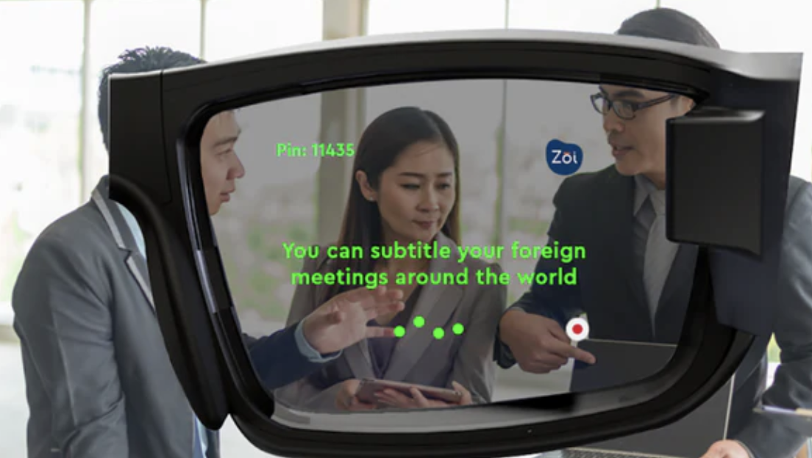
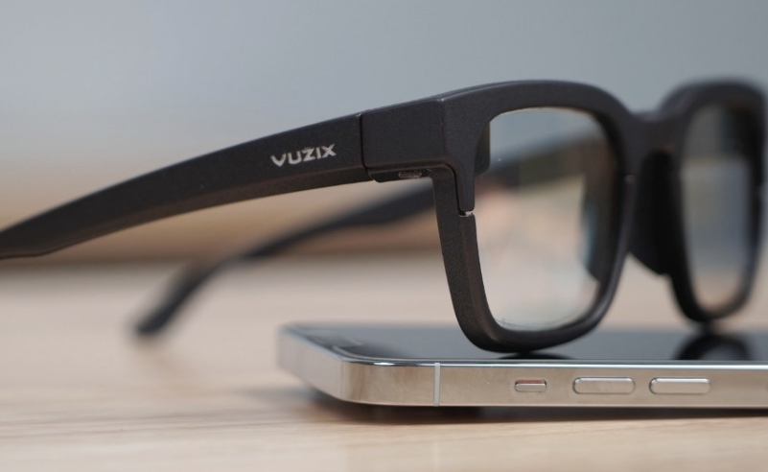
Live-caption glasses allow individuals to transcend communication limits
Live-captioning glasses enable speech-to-text transcription.
Live-captioning glasses use three agents to function.
The impact of live-captioning glasses on the future.

Slide 3
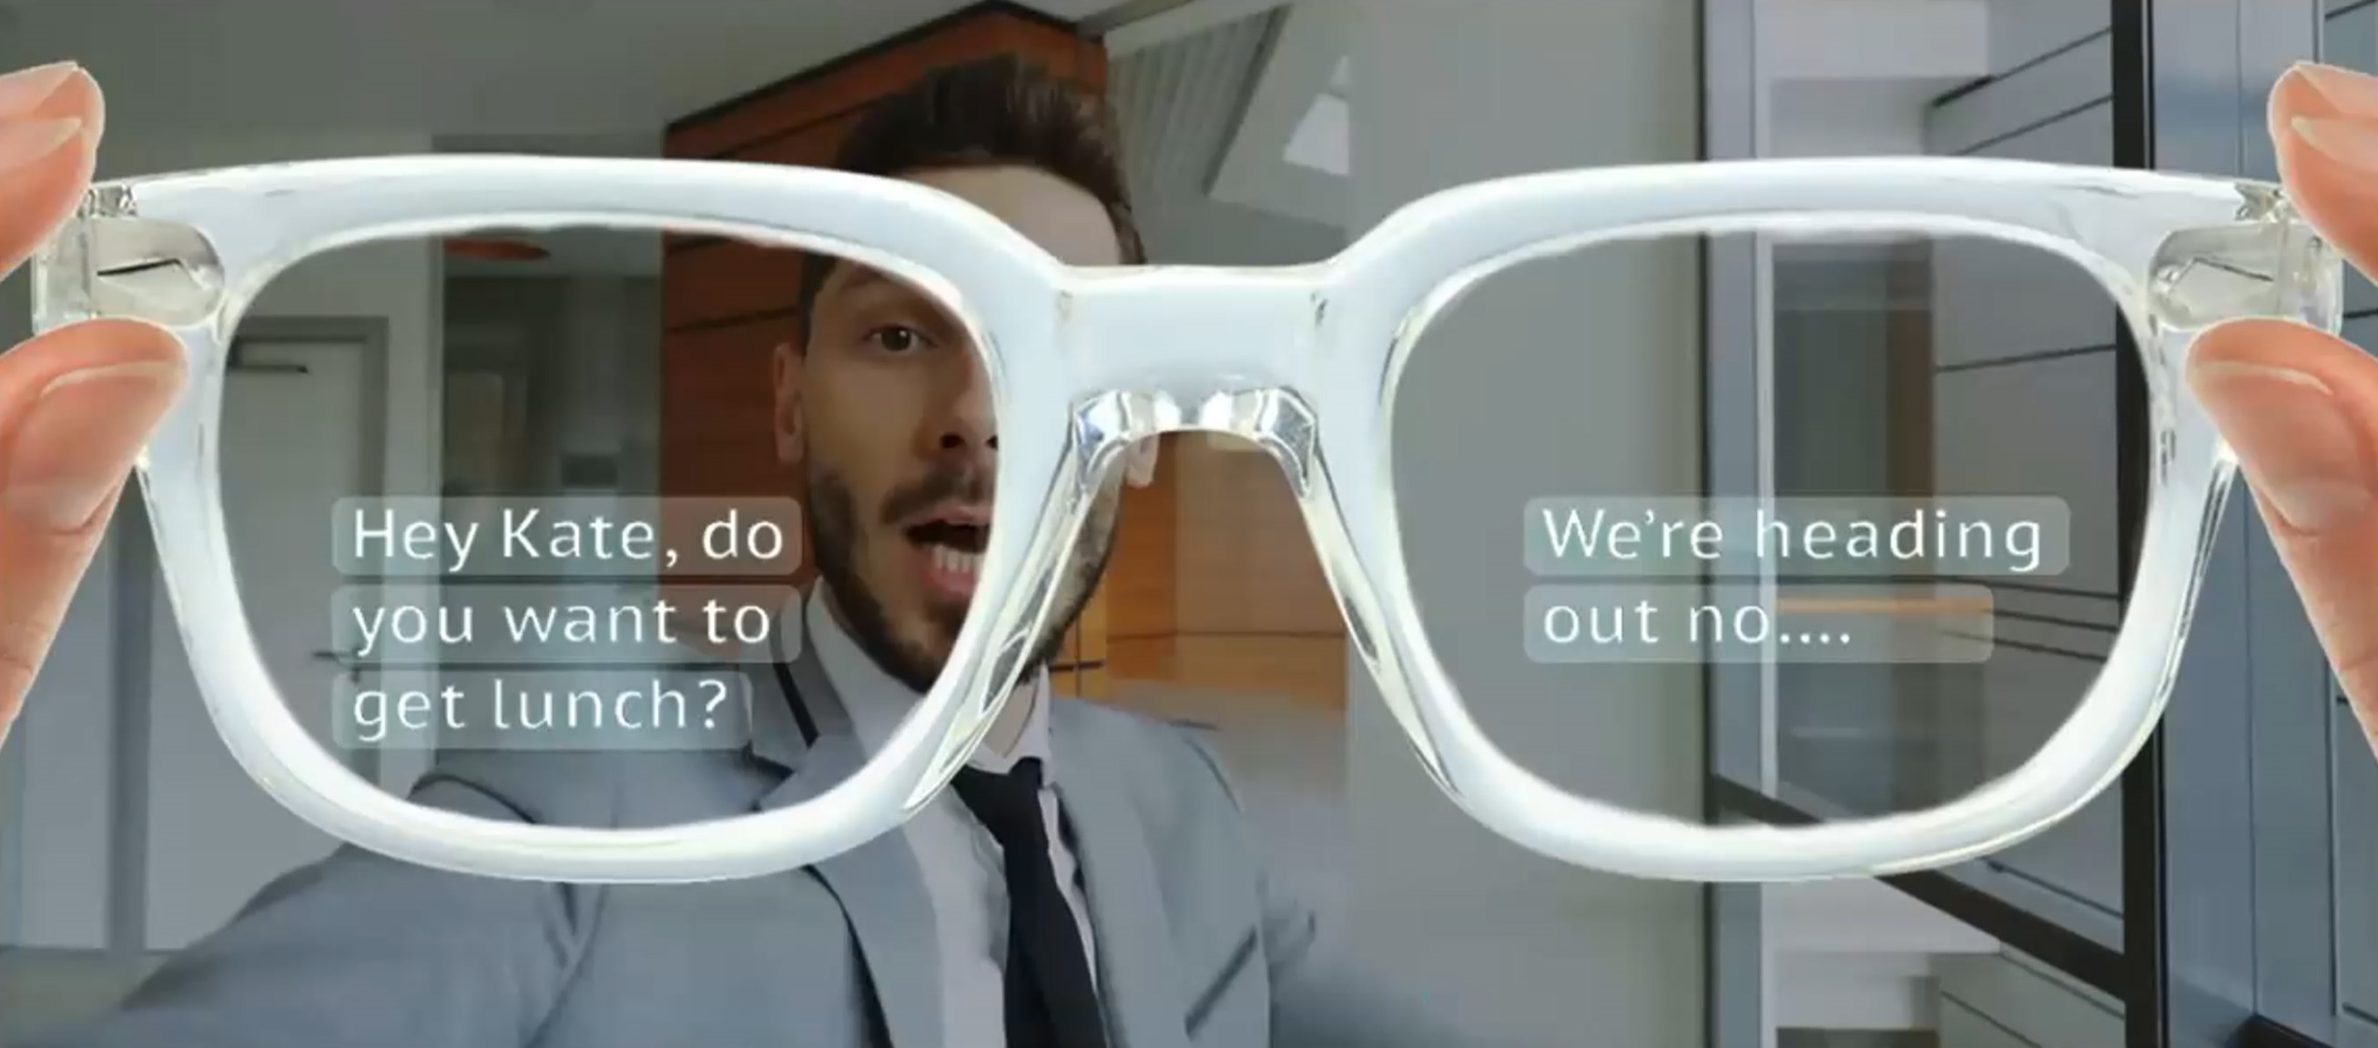
Live-caption glasses allow for real-time transcription and translation of speech-to-text.

Slide 4
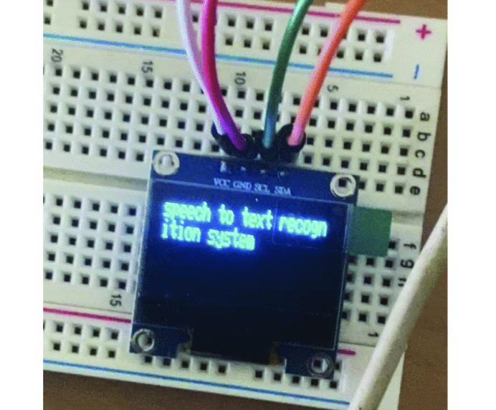
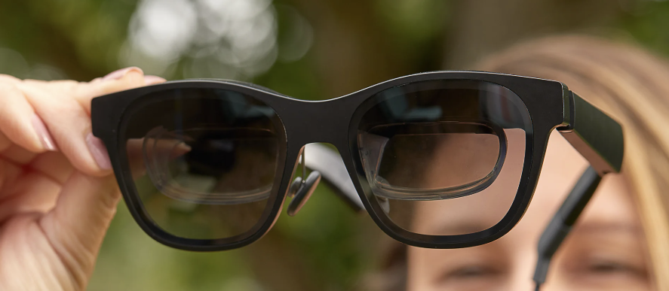
Live-caption glasses use 3 agents: microphones, transcription, and display to function.
Fig. 5
Text being displayed on the OLED display
T. Y. G, N. B G, S. R. M, R. K and L. M. Mohamed, "Advancements in Speech-to-Text Systems for the Hearing Impaired," 2024

Slide 5
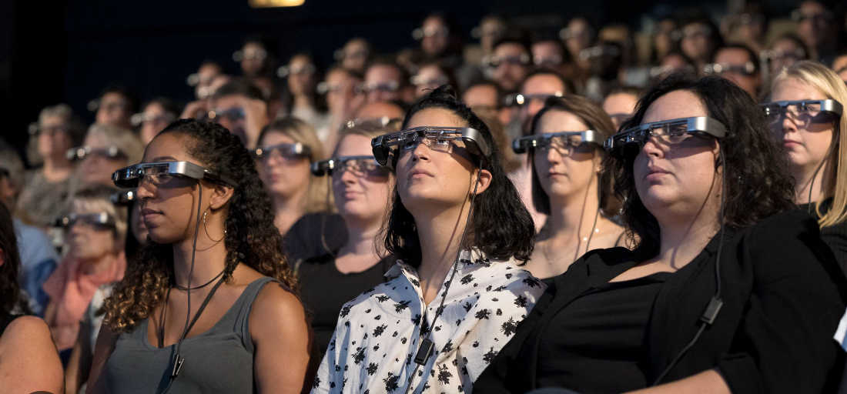
Advancements in live-transcription technology have the potential to significantly impact modern communication.

Slide 6
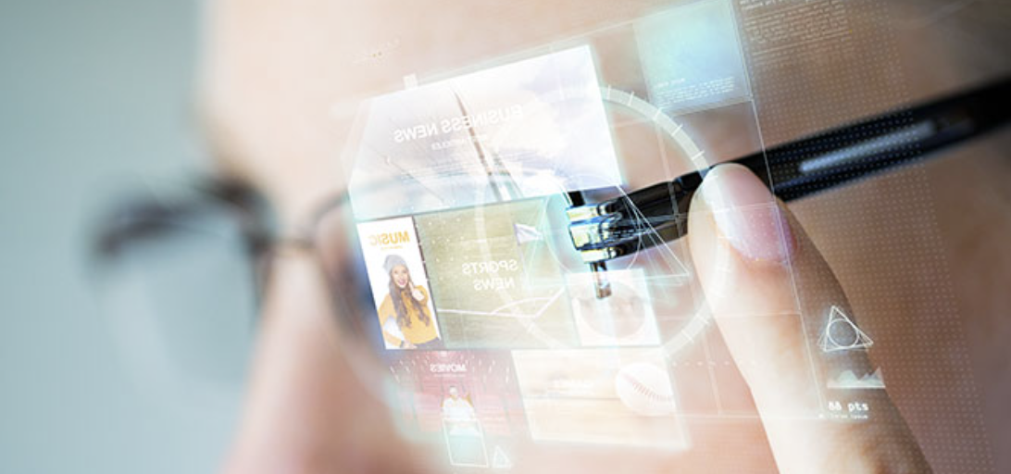
In conclusion, live-transcription classes are a revolutionary tool for the future of communication

